Slide 1
CYLINDER TRACKING USING RFID
THE TRAVANCORE COCHIN CHEMICALS

Slide 2
ABOUT CUSTOMER
The Travancore-Cochin Chemicals Ltd., popularly knows as TCC was established in 1950. The idea of establishing the unit was conceived by M/s Sheshasayee Brothers the then Managing Agents of FACT.
The venture was started as partnership concern in the name Travancore Mettur Chemicals with FACT and MCIC (Mettur Chemicals and Industrial Corporation) as partners. In 1951 the partnership was registered as a Public Limited Company, with the State Government contributing the major share of equity and the company was then named as TRAVANCORE-COCHIN CHEMICALS LTD. M/s Sheshasayee Brothers continued to be the managing agents for the next 10 years,
Customer having Several types of gas tanks for product delivery and they are facing some issues to track the items manually so that they are giving us a chance to implement RFID based cylinder tracking system into their Firm

Slide 3
CHALLENGES
THE GAS TANKS ARE COMPLETLY MADE UP OF METAL
ONLY ADHESSIVE FIXING APPLICABLE ,THEIR WERE NO PROVISION FOR WELD AND REVETING
CUSTOMER REQUIRED TO INTEGRATE WITH ORACLE
PORTALE READER APPLICATION REQUIRED FOR SCANNING
HARD TAG WITH SMALL SIZE REQUIRED

Slide 4
PROCESS FLOW

Slide 5
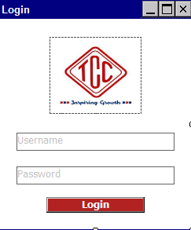
User will input the Username and Password which will be Validated against TCC ERP System, hereinafter called as TCCERP and if valid user will be redirected to main screen shown in Fig2.Modules will be available based on settings made by admin user in admin console.

Slide 6
ADVANTAGES
CUSTOMER CAN TRACK THE CYLINDERS RFOM THE FILLING AREA TO LOADING AREA EASILY WITH PORTABLE READERS
CUSTOMER CAN TAKE VARIOUS REPORTS FROM OUR STALLION SOFTWARE
THEY CAN TRACK THE MISSING LIST OR NON RETURNED CYLINDERS
CUSTOMER CAN TRACK THE RETURNED DEFECTIVE GAS CYLINDER AND MOVE TO THE TANK TO MAINTAINANCE RAEA
THEY CAN TAKE DISPATCH NOTE WITH LORRY NUMBER AND DRIVER DETAIL
CYLINDER WILL MOVE TO DISPATCHED STATUS OR WILL PROPMT THE USER WITH MESSAGE IN CASE OF ANY EMERGENCY COMES

Slide 7
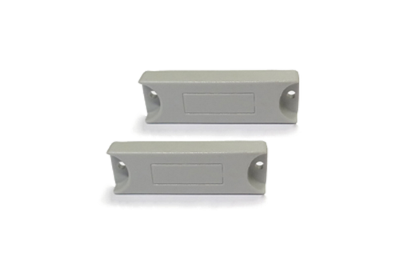
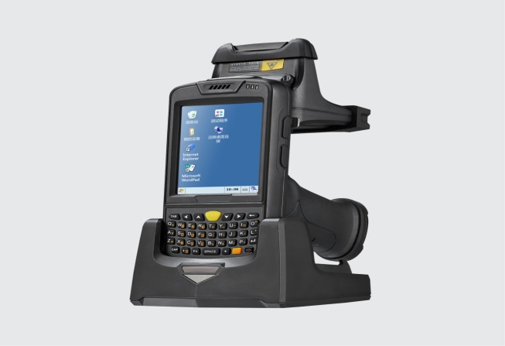
PRODUCTS USED
STA C 3000
UHF MICRO TAG

Slide 8
THANK YOU
PRESENTER NAME: PRAMOD C
CUSTOMER NAME:THE TRAVANCORE COCHIN CHEMICALS

